Slide 1
Performance Analysis of Students in Various Subjects

Slide 2

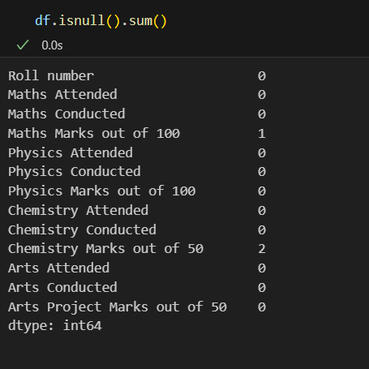
Data analysis

Slide 3
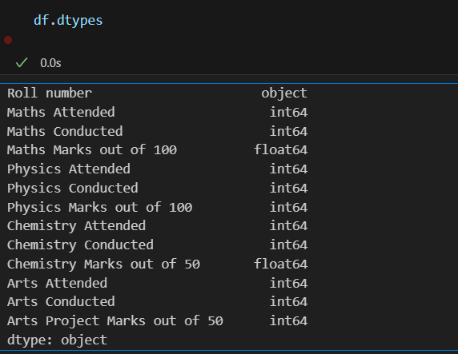
Data analysis

Slide 4
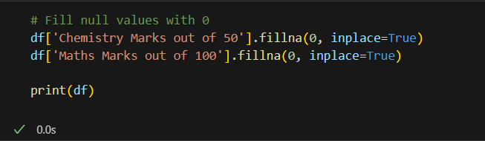
Data analysis

Slide 5
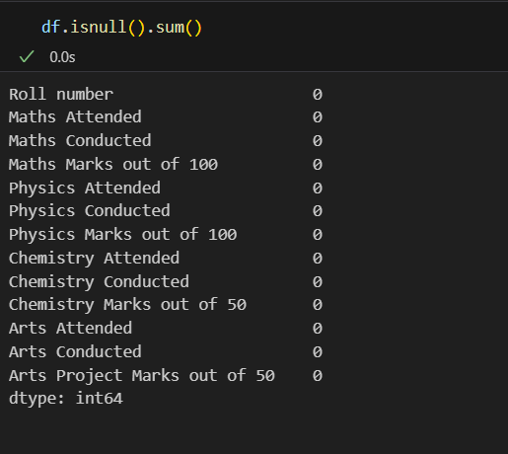
Data analysis

Slide 6
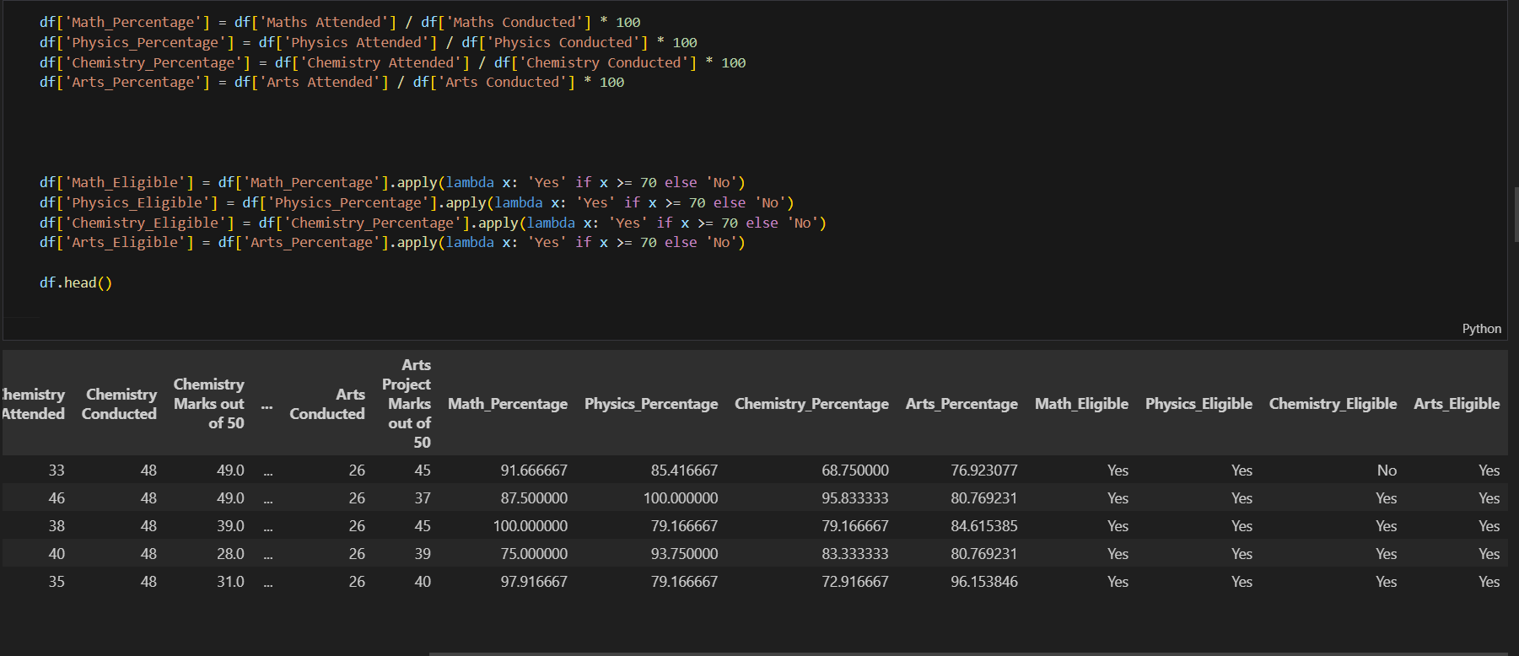
Analysis of Eligibility Criteria Based on Attendance Percentage

Slide 7
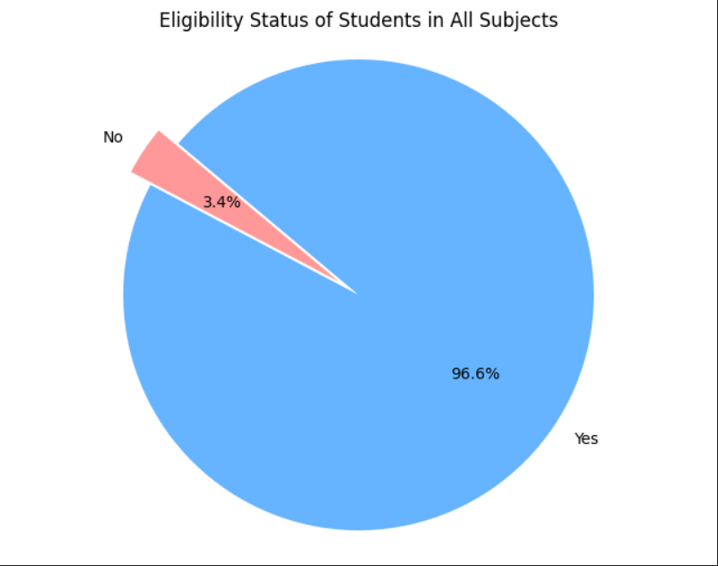
insights

Slide 8
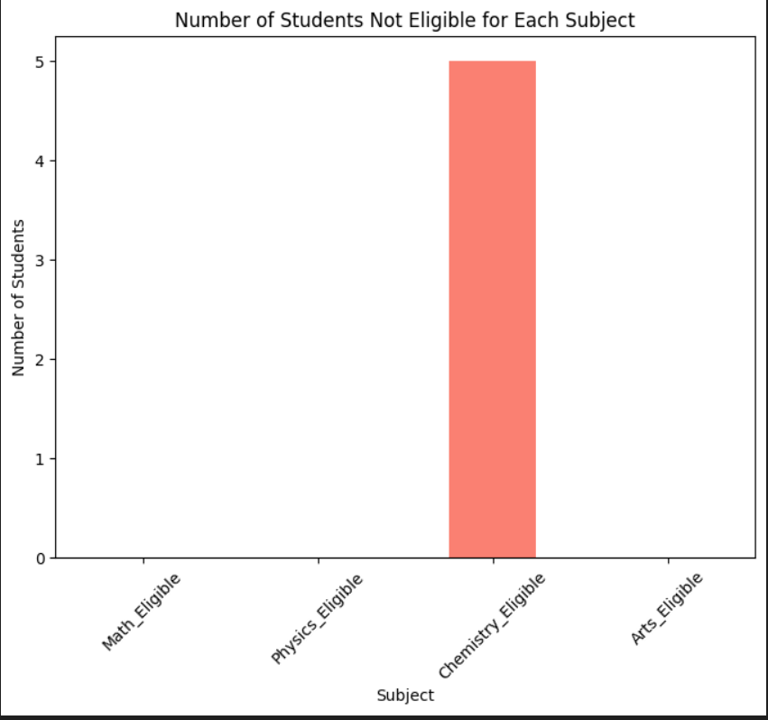
insights

Slide 9
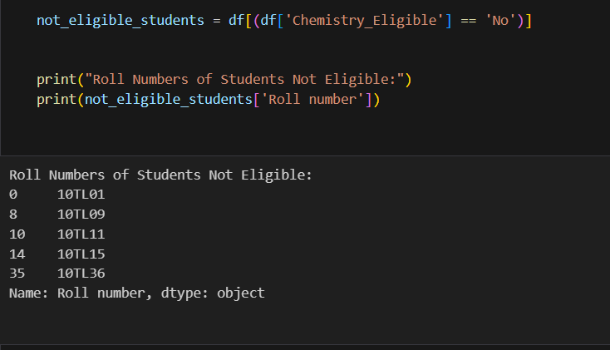
insights

Slide 10
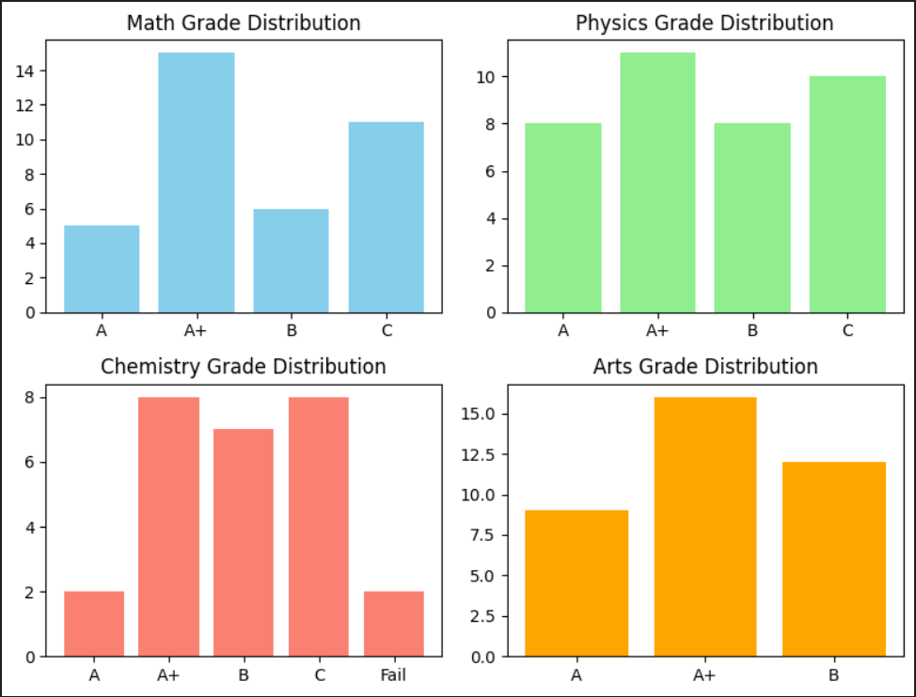
insights

Slide 11
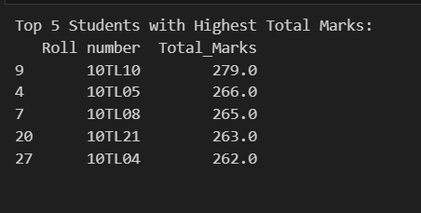
insights

Slide 12
THANK YOU

